Slide 1
Truly Intelligent Circuit Design and Implementation
Zhiyao Xie
Dept. Electrical & Computer Engineering
Duke University
Notes:
Thanks a lot for your introduction. Hi everyone, I am Zhiyao Xie, a PhD candidate from the ECE department of Duke University.
:)
Today it‘s my great pleasure to be here, at this prestigious university HKUST, and introduce my work. [pause]
As indicated by this title, in this *talk* I will discuss [pause] how to achieve truly intelligent circuit design and implementation.

Slide 2
Outline of My Talk
Part 1: My Ph.D. Works
Part 2: My Future Plan
Notes:
This talk consists of two major parts. I will spend most time covering my previous works and then talk about my future research plan. Now let’s get started.

Slide 3

Electronic Devices are Everywhere
*These images are found in public domain
Notes:
Nowadays, electronic devices are everywhere in our daily life, including smartphones, laptop, and personal computers.
:)
Let's begin our story with this tiny smartphone.

Slide 4
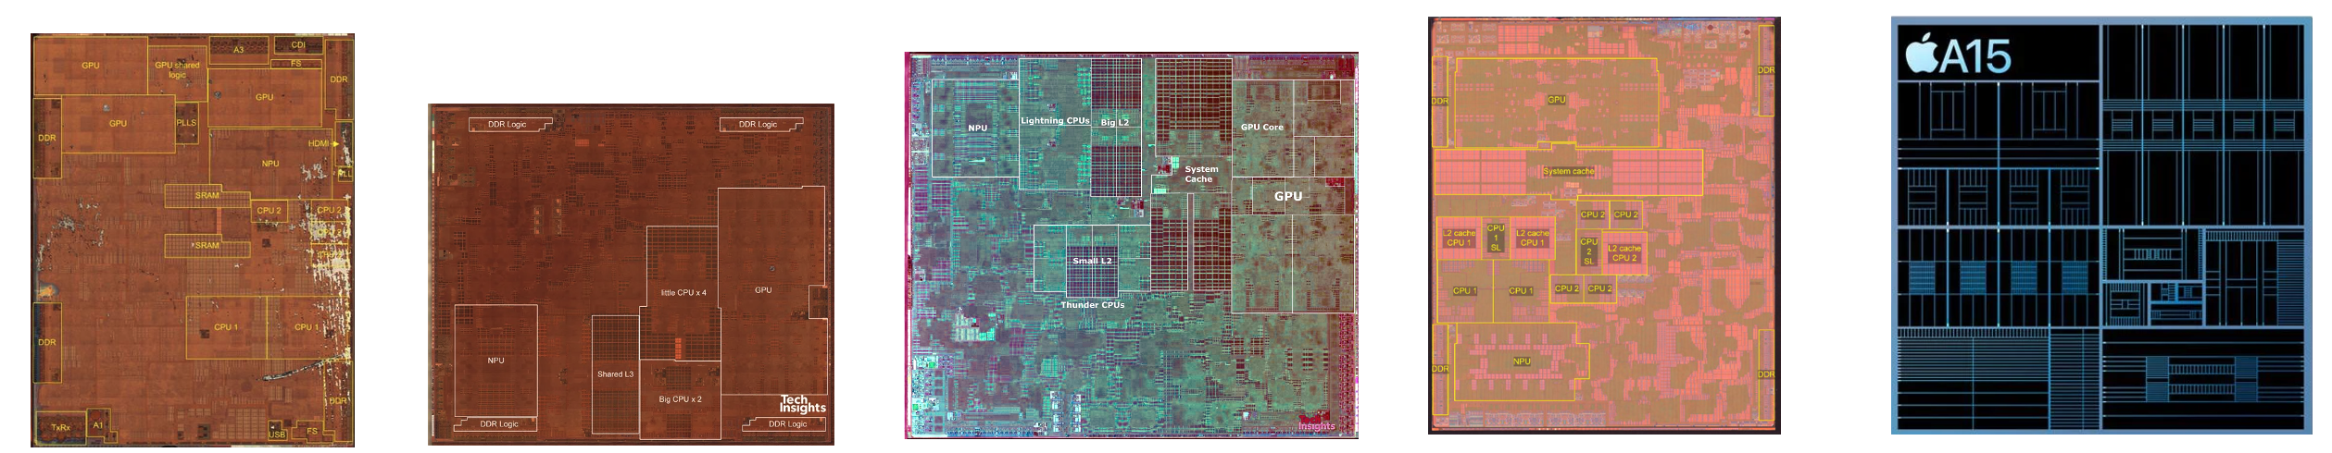

Designers Try to Deliver Generational Gains
iPhone 8, X
iPhone XS, XR
iPhone 11
iPhone 12
iPhone 13
Looks good!
Any challenges?
Apple A11
Apple A12
Apple A13
Apple A14
Apple A15
10nm
4.3 B trasistors
7nm
6.9 B trasistors
7nm
8.5 B trasistors
5nm
11.8 B trasistors
5nm
15 B trasistors
Increased integration and architecture improvements
*Source: TechInsights Inc.
Notes:
I believe we all use smartphones, [pause] and we may notice that designers are trying to deliver generational gains in their new product,
such that we have more powerful and faster chip every year.
[click]
These generational gains benefit from the increased transistor integration and architecture improvements.
As you can see from the different generations of IPhones.
This is very great, we keep getting better products as customers. [click] and can we just continue this trend to get better chips?
(Well,

Slide 5

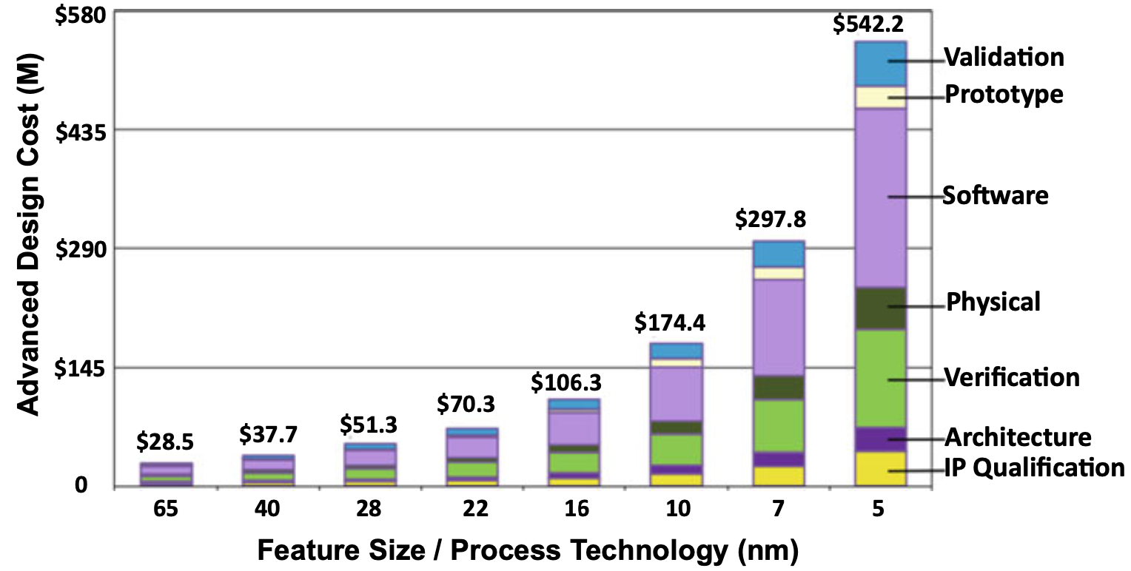
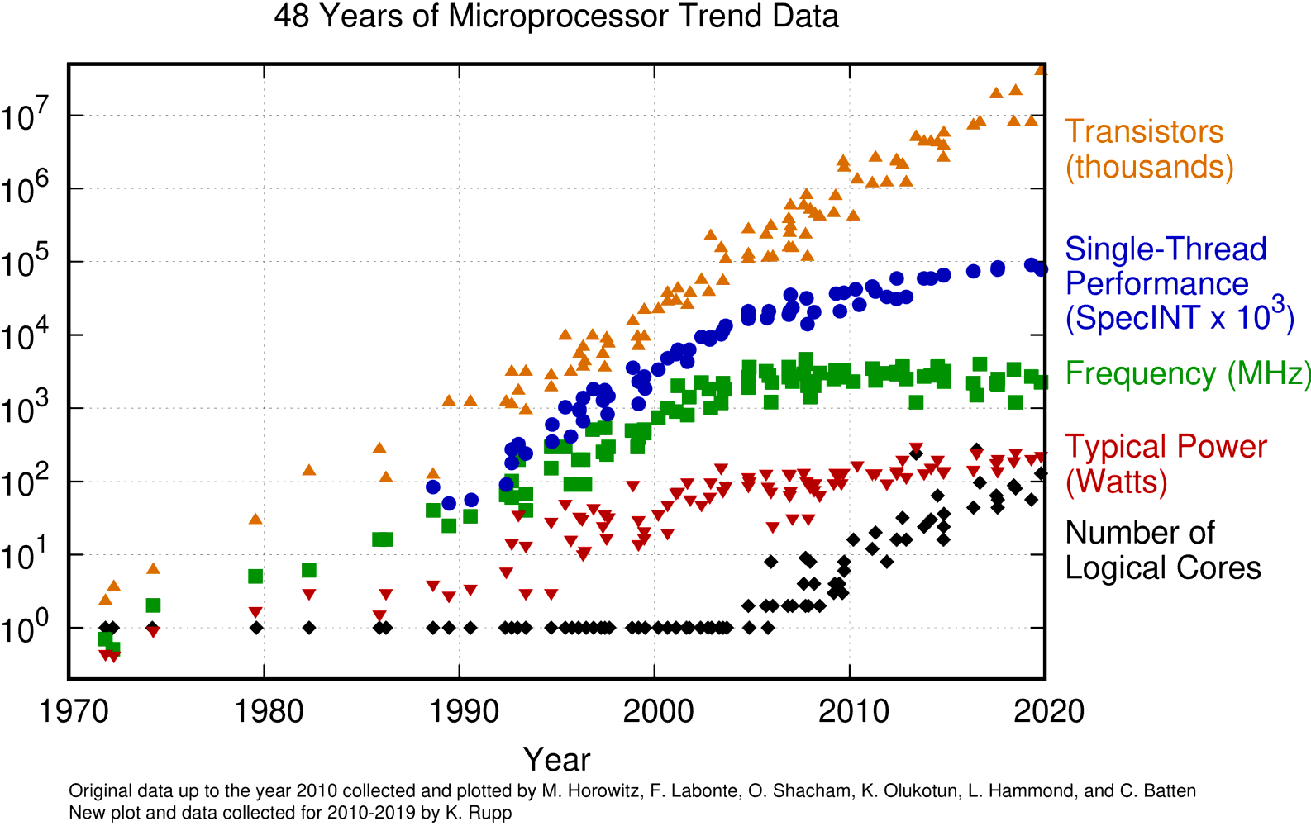
Chip Design Challenges
Diminishing performance gain and increasing design cost
Per-Core Performance Gain is Diminishing
Design Cost is Skyrocketing
(Not including manufacturing)
Partially collected by M. Horowitz et al. Plotted by Karl Rupp, 2020
International Business Strategies, 2020
Notes:
(Actually it may not be that easy),
designers face a lot of challenges when they try to design new and better chips nowadays in 2021.
first, [click] [the performance gain of each CPU core is diminishing, in terms of both single thread performance and frequency]. It means that, although the number of transistors can keep increasing, it is difficult to directly get new generation of CPU cores to run faster
The Second problem is cost, [click]. As this report shows, the design cost of circuit is skyrocketing, and it easily reaches 500 million dollars in the latest technology. And notice that this does not include the manufacturing cost. ....... It means that it's really expensive to design and deliver better chips.
And let's look at a real-life example from the industry.
[2.5 min]

Slide 6
Chip Design Challenges
Not only costly, also long turn-around time
It took several thousand engineers several years to create, at an approximate development cost of $3 billion. – Jensen Huang, CEO of Nvidia
Nvidia Tesla V100 Graphics Card
Nvidia GPU Technology Conference (GTC), 2017
Notes:
This figure shows the …….
According to …..
It indicates that chip design is not only extremely costly, but also takes long turn around time.
And you may wonder, why it's so difficult to design better chips nowadays, right?

Slide 7

This is Real Problem!
Challenges at advanced node
Inefficient chip design methodologies
Pressure from IPC and frequency
Peak power keeps increasing
Power delivery technique is limited
Increasing design rules to meet
Increasing wire parasitics, causing wire delay and noise
……
For one Arm CPU core with ~3 million gates
Intelligent design methodologies
& solutions!
Accurate power simulation takes ~2 weeks
One iteration in physical design take ~1 week
Solutions repeatedly constructed from scratch
Solutions rely on designer intuition
……
Source: The Kirin 990 SoC. TechInsights Inc.
Notes:
Well, actually there are many different challenges for chip design at advanced technology node. Here I will just list some examples and explain more about them later. [click ]
[First, designers face pressure to get better IPC and frequency in every generation of their product. ]
[As a result, the peak power keeps increasing. On the other hand, the power delivery technique is still limited. Also, designers have increasing design rules to meet and increasing wire parasitics. ] [click] [and a lot more challenges.]
In this case we really need .......
[click] for example, assuming I am a designer and I am working on this Arm CPU core with ~3 million gates] [click]
……
So I believe [pause] both the challenges and inefficient design methodologies caused the aforementioned chip design problems.
In order to solve all these problems, we need some big and fundamental changes in how we design chips. And I believe [click] we need more
/////// In my opinion, existing solutions fail to utilize knowledge from prior data, and as a result, they keep constructing similar solutions (And this is very time-consuming) ///
////
/Many researchers and engineers have extensively explored traditional solutions based on very excellent heuristic algorithms in past decades.

Slide 8
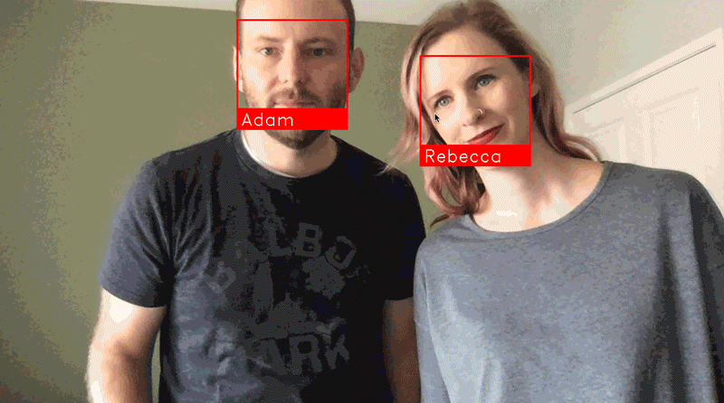
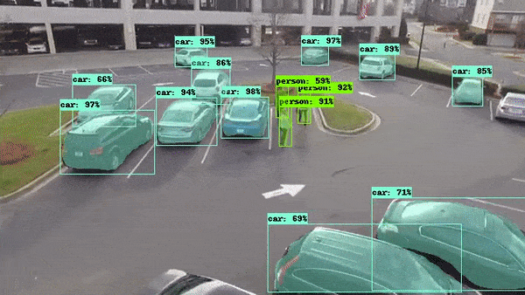


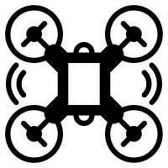










https://github.com/ageitgey/face_recognition
https://towardsdatascience.com/using-tensorflow-object-detection-to-do-pixel-wise-classification-702bf2605182
http://matclinic.com/2017/05/18/the-team-behind-the-future-of-ai-in-healthcare/
Self-driving Cars
Autopilot Drone
Robots
Smart Home
Health Monitor
Personal Assistant
Manufacturing
Smart Grid
Financial Service
HPC
Security
Gaming
Notes:
And luckily, in recent years, we have a lot of intelligence techniques,
They are referred to as AI, or ML. They have been applied to so many different applications and prove to be good at exploring prior knowledges.
[5 min]

Slide 9
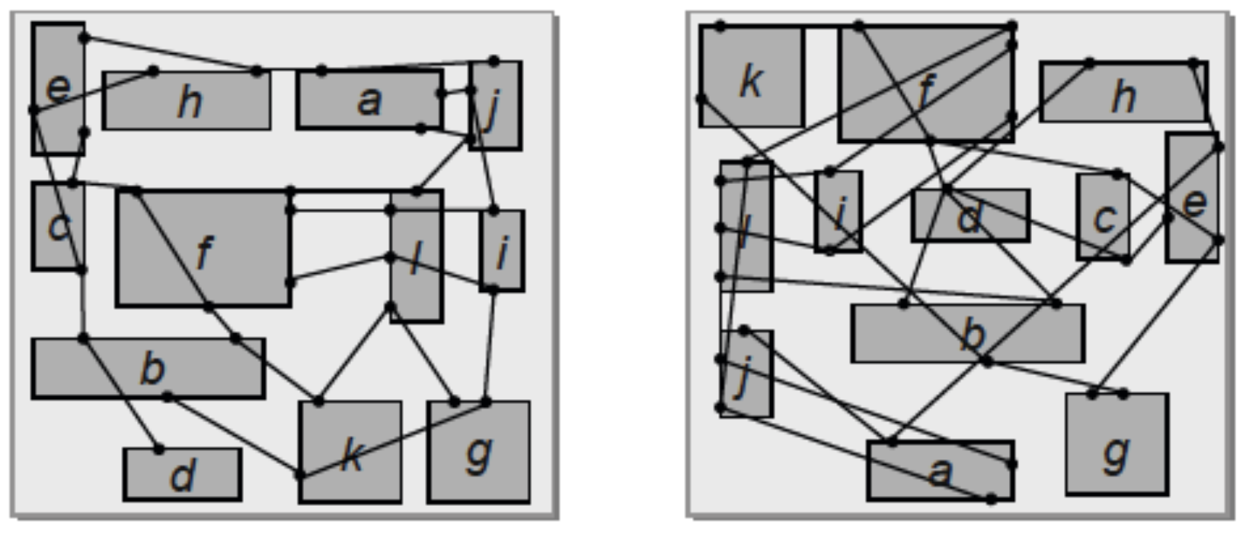
Why ML/Intelligence Helps Circuit Design?
Solvers (trial 1)
Various metrics (bad)
Simulators
……
……
Verilog
N iterations
Solvers (trial N)
Various metrics (good)
Simulators
Producing solutions repeatdly from scratch
*Source: Kahng et al., VLSI physical design
Notes:
But here is a primary question, why machine learning methods and intelligent solutions are useful in circuit design?
Here I can give one simplified example.
[click]
Assuming we have already generated the design RTL and now start to implement this design. [click] It first takes complex solvers to generate layout solutions.
[click]
And then it requires accurate simulators to measure various design metrics we care about.
Then based on the feedback, designers may adjust the solution [click]
and go through the process *again*. Until the reach the *desired* solution-quality after N iterations. [click]
[click]
We can see that, this process can be very time-consuming, and it produces similar solutions from scratch over and over again. So it is easy for us to think that,

Slide 10
Why ML/Intelligence Helps Circuit Design?
Solvers (trial 1)
Various metrics (bad)
(trial 1)
Simulators
……
……
Verilog
Fast & high-fidelity ML prediction
N iterations
(trial N)
Solvers (trial N)
Various metrics (good)
Simulators
Producing solutions repeatdly from scratch
Why not learn from prior solutions?
Notes:
…, we can largely avoid these efforts by learning from prior solutions.
And after training a model on that, we can directly perform fast and high-fidelity machine-learning predictions on the final design metrics.
So this is one simplified example on why intelligence helps,
//////
//// and of course the real application scenarios will be much more complex.

Slide 11
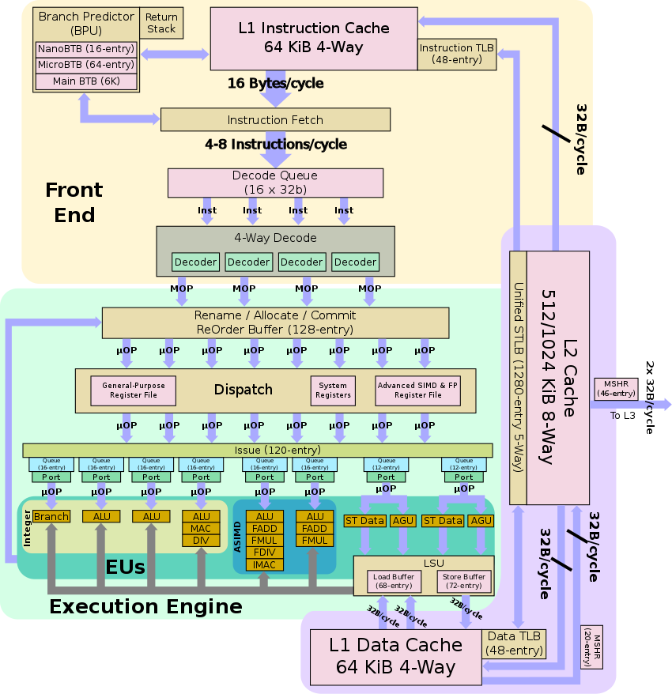
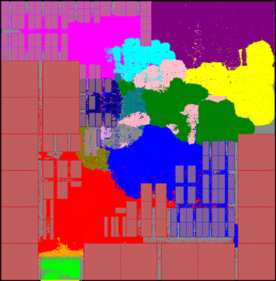

Simple Plug-in and Use of ML Engines?
Images
Circuits (Arm Neoverse N1 CPU core)
100s * 100s pixels
No extra information
Any human can tell the label
Data is everywhere
……
Millions of connected components
100s GB of raw information
Need simulations to get the label
Data is hard to get
……
Innovative Customized Solutions are Desired!
Notes:
And you may think :), ok, this is very simple, we just plug in and use some existing machine learning models.
well, actually, it may not be that easy.
[pause]
As shown here, circuits easily consist of millions of complex connected components, with hundreds of gigabytes raw-data. And you never know the label without complex simulations.
So compared with ordinary image classification or other tasks, in circuits,
the problem scale, and the correlation to extract, are orders-of-magnitude more complex.
So instead of simple plug in and use of existing ML engines, [click] [innovative customized solutions are really desired for chip design].
[7 min]

Slide 12





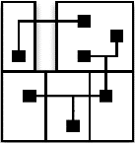








Many Excellent Exploration in Academia and Industry
Increasing number of publications on ML for chip design automation
module a
input in [2];
……
endmodule
ML for EDA in commercial tools
Synthesis
Cadence InnovusTM
UT Austin UCSD CUHK
Layout
Verification
Synopsys ICCTM II
ML for Chip Design
TAMU Duke Cornell
……
Fabrication
Google Nvidia GaTech
Electronics Research Initiative (ERI) – Design
Goal: 24 hours turnaround time & no human
Traditional Chip Design
Notes:
And it turns out that we are not the only ones who realize this.
In recent years, we have witnessed [ increasing efforts on ML for chip design automation, from both academia and industry]. Here I list representatives of them. And of course including ourselves from Duke :).
[click] As shown here, these works target different *circuit* design stages, and [click] some techniques have already been implemented and verified in the latest commercial tools, from Cadence or Synopsys.
[click]
Also, the DARPA announced an even more ambitious goal to achieve [ chip design in 24 hours without human engineers], as part of its heavily-invested ERI program.
So in recent years, [click] we can see an obvious trend from traditional chip design to machine learning for chip design. This is great.
And many researchers believe [pause] this direction will be the foundation of the next-generation design methodologies and solutions.

Slide 13
What I Believe We Should Target
Unified ML for Both Design & Runtime
Auto-ML for Chip Design
Benefit the whole chip life cycle
ML for Chip Design
Higher-level of automation
Well-studied in recent years
Traditional Chip Design
Notes:
However, I believe the well-studied ML for chip design cannot solve all problems and challenges.
And we really should target more than that.
First, [click], we can target Auto-ML in chip design, which is a natural extension to a higher-level of automation.
Second, [click], the benefit of ML methods should not be limited only to the chip *design* time. We should target ML in both design and runtime. In this way, we benefit the whole chip life cycle.
[pause]
I will cover these concepts and ideas using concrete examples in the remaining of my talk .

Slide 14
My Related Works
Power & Power Delivery Challenges
[ICCAD’20], [ASPDAC’20],
[MICRO’21] (Best Paper Award)
Power
Timing & Interconnect Challenges
[ICCAD’20], [ASPDAC’21],
[TCAD’21] (under review)
PPA
Performance
Routability Challenges
[ICCAD’18], [DATE’18], [ICCAD’21]
Area
Overall Flow Tuning
[ASPDAC’20]
Covered in this talk
Notes:
This slide shows my related works.
Chip designers are most concerned about design PPA, which stands for power, performance, and area. And I have explored all the three topics.
In this talk, due to time limit, I will cover my latest works on two topics as case studies, to demonstrate my effort in delivering true intelligence in circuit design and implementation.
[9 min]

Slide 15
My Related Works
Power & Power Delivery Challenges
[ICCAD’20], [ASPDAC’20],
[MICRO’21] (Best Paper Award)
Power
Timing & Interconnect Challenges
[ICCAD’20], [ASPDAC’21],
[TCAD’21] (under review)
PPA
Performance
Routability Challenges
[ICCAD’18], [DATE’18], [ICCAD’21]
Area
Overall Flow Tuning
[ASPDAC’20]
Covered in this talk
Notes:
This slide shows my related works.
Chip designers are most concerned about design PPA, which stands for power, performance, and area. And I have explored all the three topics.
In this talk, due to time limit, I will cover my latest works on two topics as case studies, to demonstrate my effort in delivering true intelligence in circuit design and implementation.
[9 min]

Slide 16
Case Study 1:
Routability Challenges
Notes:
New: 9 mins
The first topic I would like to introduce is about routability challenges in circuits.

Slide 17
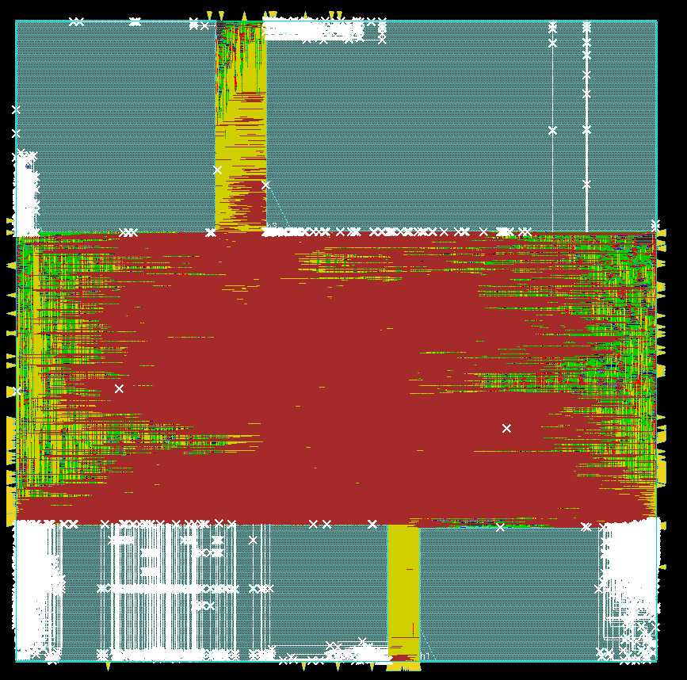
Routability Background
Design Rule Checking (DRC)
Meeting manufacturing requirements
Less DRC violations (DRV) -> better routability
DRV mitigation at early stages
Requires routability prediction/estimation
Previous routability (DRV) estimations
ML model on small cropped regions
Limited receptive field and missing global information
DRC violations (white) on circuit layout
Notes:
In chip design, after routing the metal wires, we need to perform design rule checking (DRC) [to ensure that our design meets the manufacturing requirements].
And the routability is a measurement of the quality of routing, and the level of DRC violations.
[click]
Such DRC violations need to be mitigated at early stages, and this requires routability predictions or estimations (we use these two terms interchangebly).
[click]
There have been some previous works on such estimations. However, briefly speaking, they are either inaccurate or not fast enough.
For example, some previous works apply ML models on small cropped regions of the circuit layout, which strongly limits the model receptive field. As a result, they cannot capture the *global information*, including the wire connectivity of large nets and the long-range impact from large macros.
[10 min]

Slide 18


First Deep Learning Method for Routability Prediction
Task 1: which one will result in less DRV count?
Task 2: where are DRC violations?
cat / dog
Layout 1
Layout 2
Customized CNN methods
cat
Layout 1
Layout 1
Customized FCN methods
RouteNet [Xie, et al., ICCAD’18]
Notes:
So for the routability prediction problem, I propose the first deep-learning-based solution in the world, to efficiently capture the global information of the whole circuit layout, and make a fast decision. It targets two tasks corresponding to different application scenarios.
In the first task, we are interested in a more coarse-grained problem, which is, [click] given two circuit layouts before routing, which one will result in less DRC violation count? In other word, which one has better routability?
To solve this, [click] I proposed customized convolutional neural network (CNN) methods to process the circuit layout like images *classification*. And the label is one scalar value related to the DRC violation count we are interested in.
In the second task, we require a much more fine-grained prediction. [click] We need to point out precise locations of violations on this layout, such that the *mitigation techniques* can be applied.
To solve this, [click] I proposed fully convolutional network (FCN) methods to process the layout like image *segmentation*. The label will be the distribution of DRC violations on the layout.

Slide 19
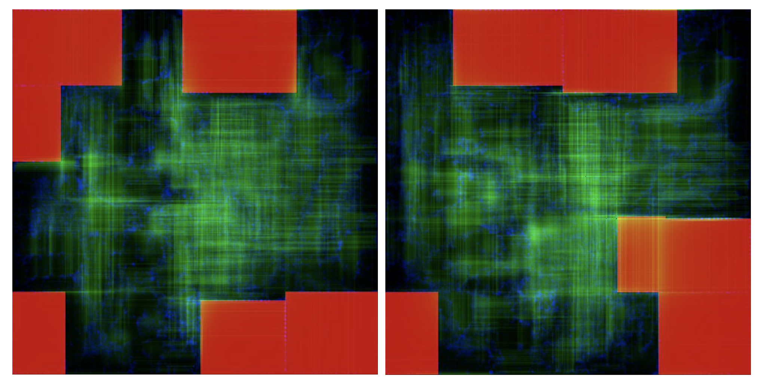
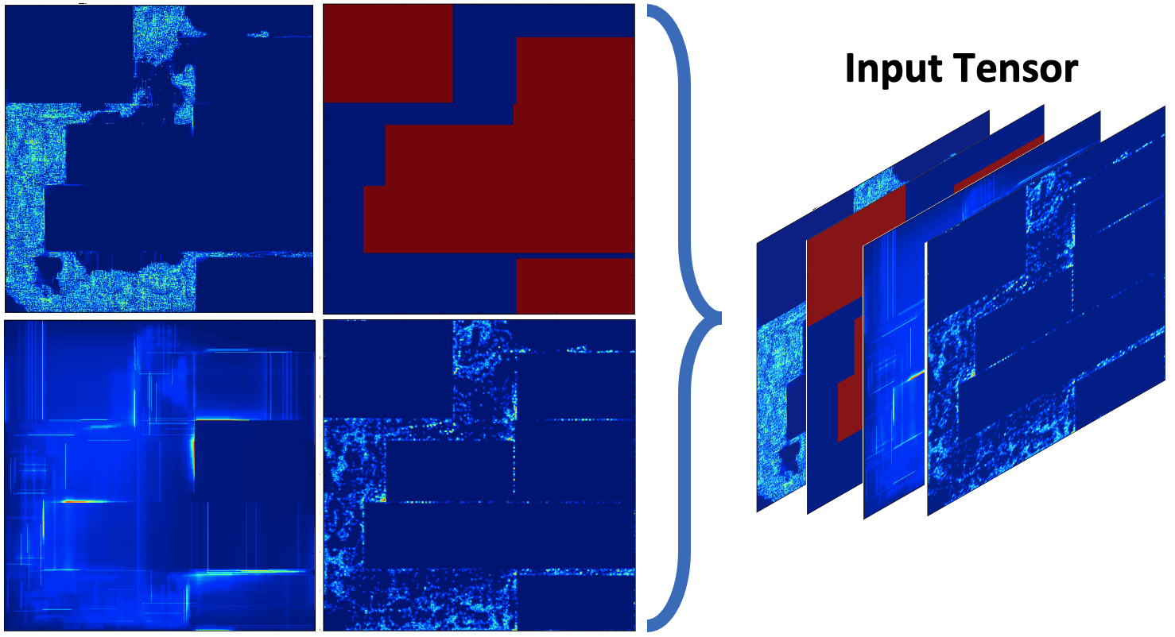
First Deep Learning Method for Routability Prediction
Task 1: which one will result in less DRV count?
Task 2: where are DRC violations?
Requires global routing:
Hours * Number of Layouts
In seconds, with similar accuracy
Requires detailed routing
More hours * Iterations
In seconds, outperform previous works
RouteNet [Xie, et al., ICCAD’18]
Notes:
And these figures show what inputs from *real* circuits look like in both tasks.
In the first task, traditional evaluations like global routing will take *hours* to measure the violation count for each layout. In comparison, [click] our work only takes *seconds*.
In the second task, it takes even longer to find precise locations of violations. [click] And our methods also only take seconds.
[12 min]

Slide 20
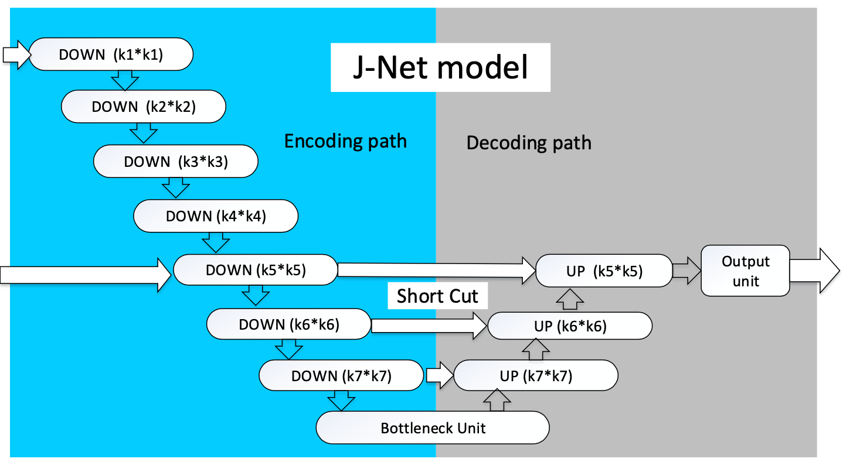
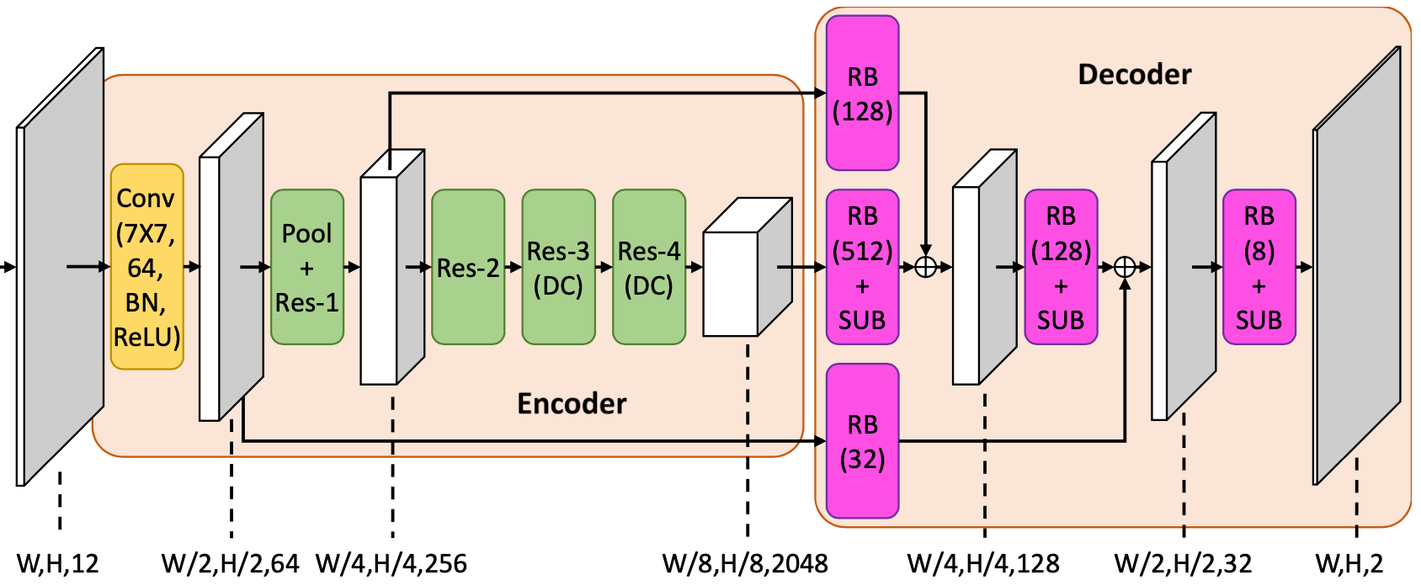
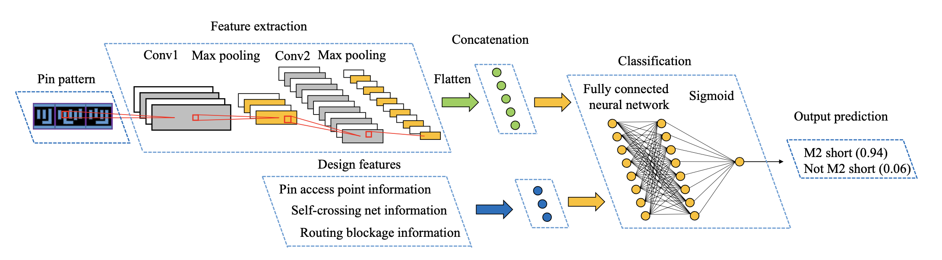
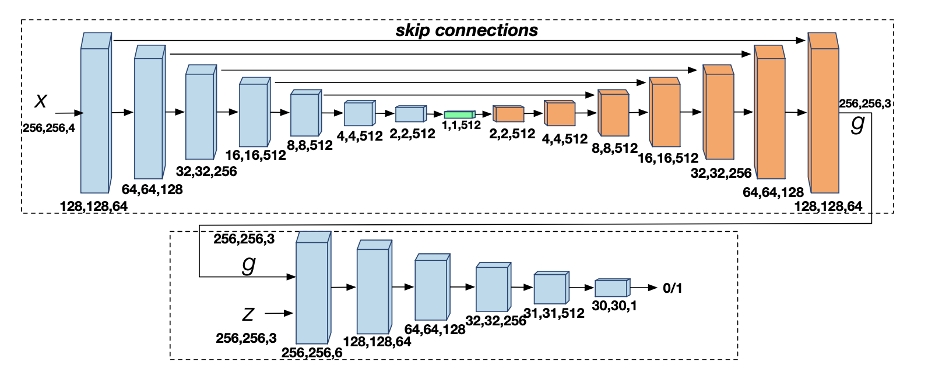

Many Excellent Deep Learning Methods
RouteNet [Xie, et al., ICCAD’18]
J-Net [Liang, et al., ISPD’20]
PROS [Chen, et al., ICCAD’20]
Tremendous Engineering Efforts Required!
[Yu, et al., DAC’19]
Painting [Yu, et al., DAC’19]
Notes:
After my first deep learning-based routability estimator, [click] we see a lot of excellent deep learning methods on this topic as routability estimators. Their methods are very carefully designed and achieve good results on their own benchmarks.
However, it is easy to see that these very well designed methods take a long time to develop. And also, [click] tremendous engineering efforts are required.

Slide 21
What I Believe We Should Target
Auto-ML for Chip Design
ML for Chip Design
Higher-level of automation
Well-studied in recent years
Traditional Chip Design
Notes:
So it's natural for me to think we can actually avoid this cost by automating this model development step with auto-ml methods.
This works as a higher-level of automation. To illustrate this, I will introduce one of our latest work in automatically developing routability estimators.
[13 mins]

Slide 22
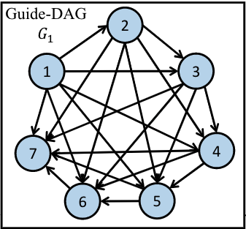


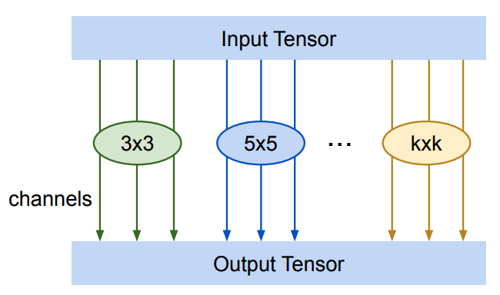
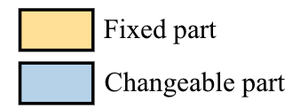
Automatic Estimator Development – Search Space
Candidate node operations
C32
C64
Atr
Mix
Atrous/dilated convolution
Mixed (depth-wise) convolution
Sampling sub-graph
Standard convolution
[Chang, et al., ICCAD’21]
Notes:
In this work, the idea of automating estimator development is well implemented by our first-year phd student, Chen-chia. Chang.
This figure shows the general model architecture of our proposed routability estimator.
There are altogether six blue blocks, representing large searchable parts, and the yellow blocks are simple fixed parts.
======
[click] Then we look at the search space of each blue searchable block.
Each block is independently sampled from this completely-ordered graph with seven nodes. Each node denotes one convolutional operation, and each edge denotes the data path.
[click]
- For each node, its convolutional operation is selected from four options. The first two options are standard convolutions with 32 or 64 kernels. Denoted as the C32 and C64 here.
Besides these standard convolutions, [click] we also include the Atrous or named dilated convolution in the candidate operation. As this animation shows, it looks at a *larger* range of inputs.
In addition, [click] we also include a more complex option, [-It is a mixed convolution operation]. It supports different size of convolution kernels for different channels.
As for the edges, since these edges are [- sampled from completely-ordered graph], So it supports any combinations of node connections.

Slide 23
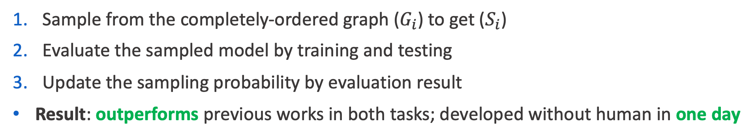
Automatic Estimator Development – Searching Algorithm
Sample from the completely-ordered graph ($G_{i}$) to get ($S_{i}$)
Evaluate the sampled model by training and testing
Update the sampling probability by evaluation result
Result: outperforms previous works in both tasks; developed without human in one day
Notes:
Besides the model search space, the other key component of the method is searching algorithm we used to find the best model. This slide show the overall searching framework, which consists of three simple steps in each searching iteration.
[click]
In the first step, each blue searchable block is sampled from the aforementioned completely-ordered graph as search space.
[click]
After the sampling, we train the sampled model and then evaluate its performance on the validation set.
[click]
Then we just use the evaluation result to update the sampling probability. So the idea is, if the performance is good, then the probability of corresponding structures being sampled again becomes higher.
[click]
And let's look at the result.
This simple and straightforward algorithm turns out to work surprisingly well. The model development can finish within one day without human developers, and it outperforms all tested previous human designed models, in our experiment.
[pause]
[And Before I finish introducing this work,] I would like to show what the automatically developed models *look* like. Their structures turn out to be very interesting.

Slide 24
Auto-developed Model Structures
Human-designed models:
Highly hierarchical and organized architecture
Limited operation types
Auto-developed model:
Construct parallel branches and flexible interactions
Supports different operators
Auto-developed model for DRC hotspot detection (fine-grained task 2)
Notes:
This is the automatically developed model on *DRC hotspot detection*, the second task I introduced. And remember that the nodes denote different convolution operations. We can see that this structure is obviously not designed by human engineers.
[click]
Because most human-crafted models tend to adopt a [highly hierarchical and organized architecture], which may lack the flexibility to aggregate different levels of embeddings. In addition, they usually only adopt a limited number of convolutional operators.
[click]
In contrast, the automatically developed model supports many parallel branches and flexible interactions. This inherents from the topology of the graph-based search space.
In addition, it supports us to increase the number of operations at the nodes, which increase the diversity of feature representations.

Slide 25
Auto-developed Model Structures
Auto-developed model for DRC hotspot detection is significantly more complex
Simpler model
Auto-developed model for violated count prediction (coarse-grained task 1)
More complex model
Auto-developed model for DRC hotspot detection (fine-grained task 2)
Notes:
And we also compare the developed models for both tasks. The task 2 at the bottom is much more challenging because of its fine-grained prediction.
As a result, the developed model for task 2 at bottom is *also much more complex*, [click] especially near its output.
So the essential difference between these two tasks is clearly captured and reflected by the two discovered models.
In summary, we not only have better performance with much less development time and human effort, the output models are also intuitively reasonable. It may directly inspire *further* model development for routability estimation in the future.

Slide 26
Case Study 2:
Power & Power Delivery Challenges
Notes:
New: 17.5 mins
So I have presented the concept of ML for chip design and auto-ML for chip design, using the challenges from routability problems.
The next and more important topic that I would like to discuss is about power and power delivery challenges.

Slide 27
What I Believe We Should Target
Unified ML for Both Design & Runtime
Auto-ML for Chip Design
Benefit the whole chip life cycle
ML for Chip Design
Higher-level of automation
Well-studied in recent years
Traditional Chip Design
Notes:
In this case study, I will introduce another latest work which achieves my higher goal. It is not only automatically developed, but also provides a unified ML model for both design and runtime, benefiting the whole chip life cycle.
So in this case, it's not only machine learning for circuits, but also machine learning in circuits.

Slide 28
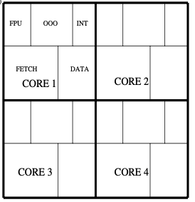




Challenge 1 – Design-time Power Introspection
256b SVE
256b
8-wide
Fetch
$$+$$
$$=$$
256b
256b
5-8-wide
Decode/Rename
256b
15-wide
Issue
$$+$$
$$=$$
256b
256b
Many-core CPU with more transistors
Wider issue
More vectored execution
Delivering generational performance gains adversely impacts CPU power
Power-delivery resources not keeping pace with CPU power demands
Increasing power-sensitivity drives the need for design-time introspection
APOLLO [Xie, et al., MICRO’21] (Best Paper Award)
Source: Arm Neoverse V1, 2021
Notes:
[pause]
I want to begin by talking about the problems that drive this work. And that starts with the fundamental trade-off between CPU performance and power-consumption.
As I introduced, CPU designers put significant effort in [delivering generational gains in performance]. However, this is increasingly difficult and requires more transistor integration, further parallelism and more vectored executions.
This of course inevitably cause higher switching activities, which adversely impacts the CPU power and current demand.
On the other hand, [click] [Power-*delivery* resources have not kept pace. For example, metal interconnects are particularly resistive at 5nm and below. Also, packaging technology has progressed at a slower rate and unable to sustain the di/dt demands of modern CPUs.
[click] Due to this [increased power sensitivity, there is a greater need for design-time power introspection]

Slide 29
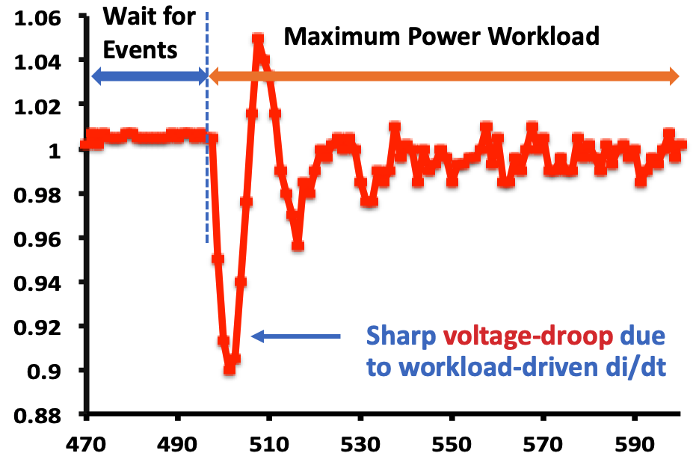
Challenge 2 – Run-time Power Introspection
Modelling power on one μarch block
Measured di/dt event on Arm A72 SoC
Different workloads
Ground Truth Power
On-Chip Supply Voltage (V)
Limited accuracy
Estimated Power with Manual Proxies
Time (ns)
Peak-Power mitigation requires accurate power estimation to drive throttling
Manually inferring proxies is very difficult in complex modern CPUs
Abrupt changes in CPU current-demand (di/dt event) leading to deep voltage-droop
Notes:
Not just design-time, modern CPU systems also need power and thermal management at their runtime.
For example, peak-power mitigation techniques often rely on pipeline instruction throttling. The throttling algorithms are driven by manually inferred power-proxies. However, inferring proxies manually is very difficult in complex modern CPUs.
[click] A more serious problem is the [ abrupt changes in CPU current demand, named di/dt events], which leads to deep voltage-droops.
As shown in this right figure, when there is a workload-driven increase in power or current demand, there would be a sharp voltage droop in a very short time.
This raises a high requirement on the response latency of mitigation or power management techniques.

Slide 30
Challenge 3 - Workload Power Characterization
Need power-characterization of real-world workloads
Simple micro-benchmarks not longer sufficient
Single SPEC simpoint can take weeks on the expensive emulator
Power measurement is expensive
Only average power consumption available
Impossible to scale to di/dt event analysis
Simpoint binary
Compile workload
Simulate on netlist on emulator
Gate-level netlist
Offline windowed simulation trace
Power analysis
Windowed average power
Industry-Standard Emulator-Driven Power Flow
Notes:
Getting these runtime mitigations correct is very important and difficult. To ensure the correct mitigation, designers need careful and extensive power-characterization, or modeling with real-world workloads. (instead of simple micro-benchmarks)
[click] In industry, this is done by using an emulator to emulate the entire netlist. However, the emulator is expensive and this flow can take up to weeks.
[click] In addition, this only gives us average power consumption over millions of cycles. This does not scale to the analysis on aforementioned di/dt events, because of its limited temporal resolution.
[21 min]

Slide 31
Challenges from Both Design-time and Runtime
A unified solution for both scenarios
Runtime Challenges Summary
What is An “Ideal” Power Estimator?
Peak power mitigation
Difficult to manually infer proxies
Voltage droop (Ldi/dt) mitigation
Require very low response latency
Accurate yet fast
Achieve high temporal resolution
Low runtime on-chip overheads
Easily extensible to diverse designs
Design-time Challenges Summary
Simulation on realistic workloads
Expensive and slow
Limited temporal-resolution
Notes:
So, we encounter combined challenges from both design-time and runtime. And here is a summary of these challenges.
[pause]
To solve all these problems, we have a much higher requirement on *power modeling*, which is significantly beyond the capability of all existing power estimators.
[click]
And that drives me to think [what is an ‘ideal’ power estimator]? Let’s dream big on this.
First, of course an ideal power estimator has to be accurate and also fast.
Second, it should achieve high temporal resolution with fine-grained power measurement windows, such that it enables us to look into the peak power problem and di/dt events
Third, we should be able to implement the model on-chip as part of the CPU core with very low overheads.
And last, this estimator should be easily extensible to diverse designs. so we do not need to develop it separately for each design.
So this the most ‘ideal’ or even ‘perfect’ power estimator I can dream of. And then I make it is possible in this latest work.

Slide 32
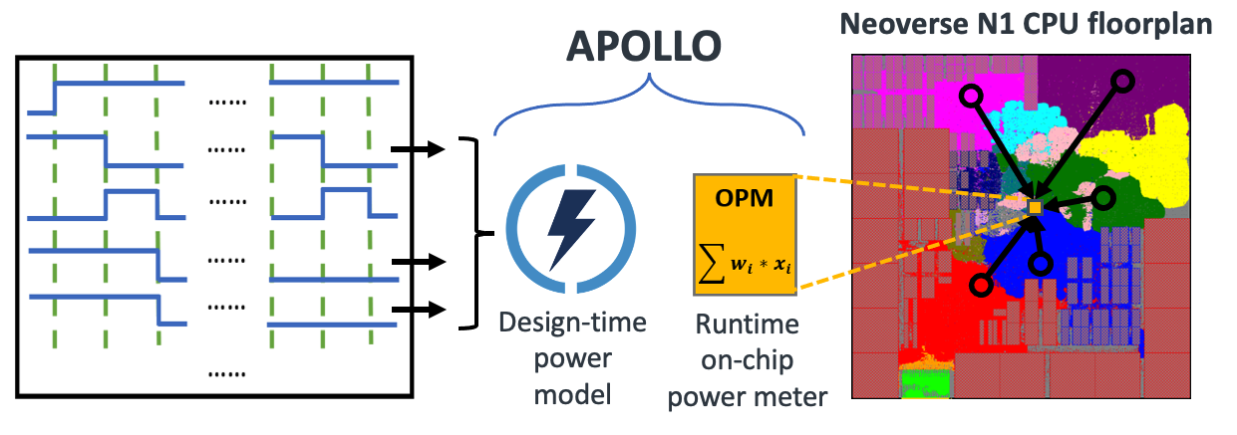
APOLLO: A Unified Power Modeling Framework
Fast, yet accurate design-time simulation
Single-cycle temporal resolution
Low-cost, yet accurate runtime monitoring
Design-agnostic automated development
Notes:
In this work, I propose a unified power modeling framework targeting both design-time and runtime scenarios, named APOLLO, as shown in this figure.
[click]
Firstly, It provides fast and accurate power simulation at the CPU design-time. It finishes the power simulation of millions of cycles in minutes with 90%-95% accuracy. [click] And it supports single-cycle temporal resolution.
[click]
And the APOLLO model can be directly synthesized as part of the CPU RTL. It achieves extremely low cost and accurate runtime on-chip power monitoring.
[click]
In addition, the development of this method is fully automated without human knowledge, and it is design-agnostic. It means that this method applies to all manners of compute solutions, not just different versions of CPUs, but also GPUs, NPUs, and even sub-blocks.
[23 min 15]

Slide 33
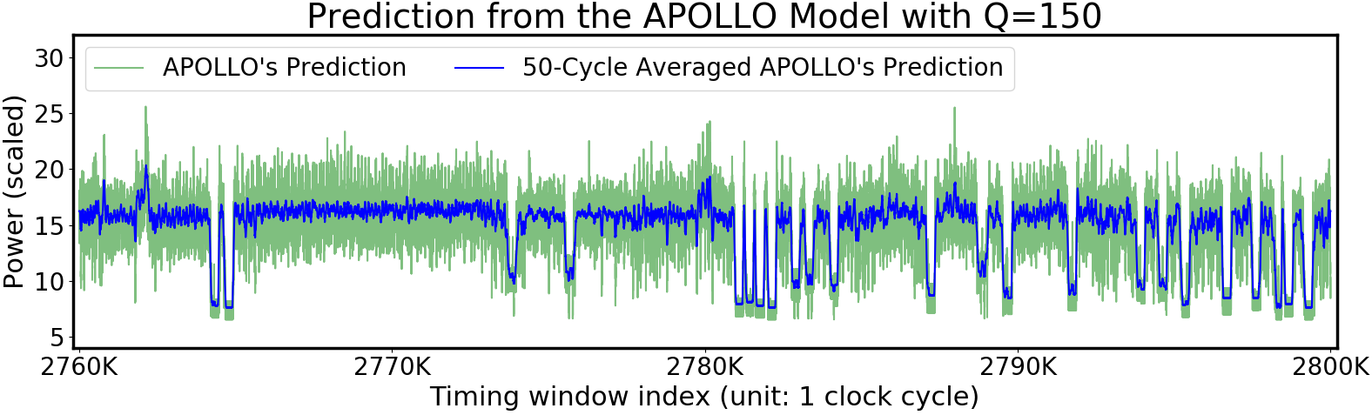
A Workload Execution Preview of APOLLO
40K cycles of APOLLO Power Estimation out of a trace of 17M cycles
hmmer (SPEC 2006) simpoint
on the Neoverse N1 CPU core
~2 weeks execution time reduced to few minutes on the emulator
Unprecedented power-introspection due to single-cycle temporal resolution
Notes:
Before introducing the method in detail, I would like to first show a workload execution preview with APOLLO. This trace is hmmer simpoint from SPEC, running on the Neoverse N1 CPU core.
The entire simpoint is 17 Million cycles, and here I show part of the trace with 40 Thousand cycles. [click] Running this simpoint on the emulator takes about 2 weeks overall. In comparison, APOLLO can approach within 90-95% of the signoff accuracy within a few minutes.
[click]
Also, I want to emphasize the per-cycle temporal resolution in this plot – It enables us to trace workload-driven variations in current demand. This fine-grained temporal resolution cannot be achieved by other techniques with this speed.
So these are the strength of APOLLO, now I will start to introduce how we construct such a model.

Slide 34
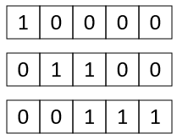
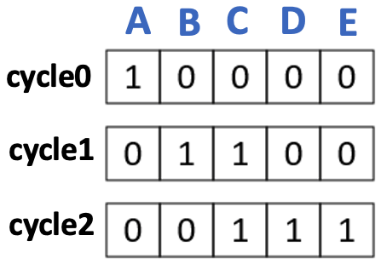
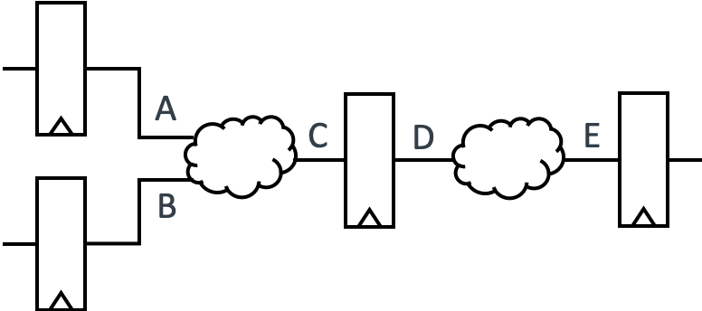


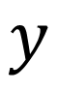
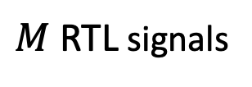
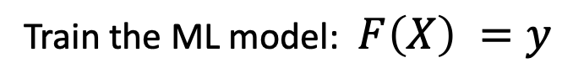
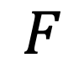
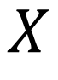

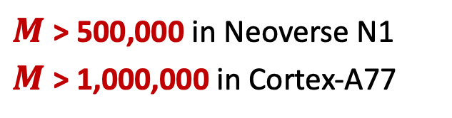
APOLLO Feature Generation & Model Training
A
B
C
D
E
Power
cycle0
P0
$$X$$
$$y$$
cycle1
P1
cycle2
P2
A
B
P0
P1
P2
$$……$$
C
$$F$$
=
D
$$……$$
$$……$$
E
A design in RTL level.
$M$ RTL signals
cycle0
cycle1
cycle2
Train the ML model: $F\left(X\right) =y$
In .fsdb/.vcd file format
$M$ > 500,000 in Neoverse N1
$M$ > 1,000,000 in Cortex-A77
Notes:
This slide shows how I train the power model based on any given design [click]. I first generate simulation traces [click] of all RTL signals.
After that, at each cycle[click], I collect the toggling activity of all signals. Here 1 means toggle and 0 means not toggling.
In this way, this waveform can be converted to [click] a matrix of toggling activities. And this is the raw input of our model [click], denoted as X. The horizontal dimension of the feature equals the number of signals in the design [click], denoted as M.
Our ground-truth labels are per-cycle power [click] from simulation. Denoted as this y [click]. Our goal is to [click] construct a data-driven model F by training with X and y
However, for industrial microprocessors, [click] the number of features M can be larger than one million. This high dimensional input will make the power model F rather inefficient.

Slide 35
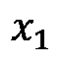
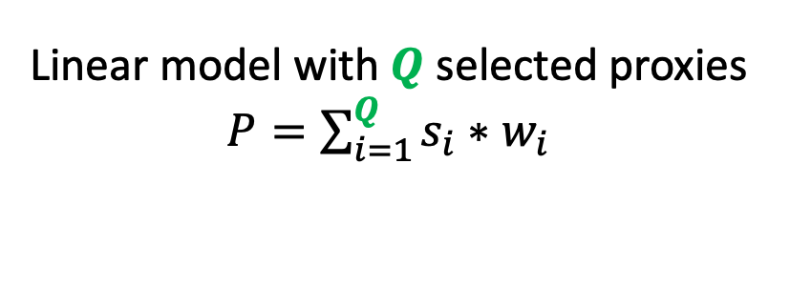
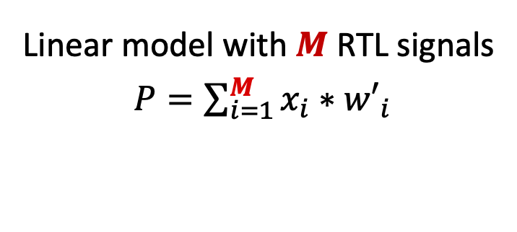
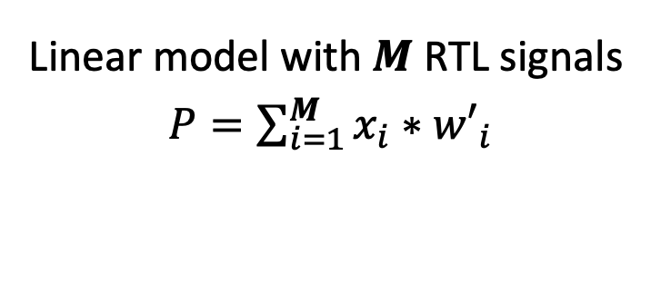
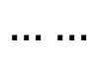
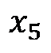
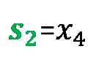
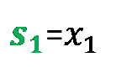
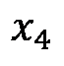

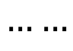
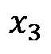
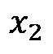

Simple Key Ideas
Linear model can estimate power accurately
Small portion of signals (proxies) can provide enough information
$M$ signals
$Q$ selected proxies
Auto-
Selection
A
B
C
D
E
A
B
C
D
E
Each cycle:
$$……$$
Each cycle:
$$……$$
$$x_{1}$$
$$x_{2}$$
$$x_{3}$$
$$x_{4}$$
$$x_{5}$$
$s_{1}$=$x_{1}$
$s_{2}$=$x_{4}$
Linear model with $M$ RTL signals
$P=\sum_{i=1}^{M}{x_{i}∗{w′}_{i}}$
Linear model with $Q$ selected proxies $P=\sum_{i=1}^{Q}{s_{i}∗w_{i}}$
Linear model with $M$ RTL signals
$P=\sum_{i=1}^{M}{x_{i}∗{w′}_{i}}$
Notes:
To solve this, my solution is developed based on two simple ideas. [click]
First, the dynamic power iteself is a linear function of all swtiching capacitance. So I reasonably assume [click] a good linear model can potentially deliver accurate results. But in this case [click] the input signal number M is still large.
So my second key idea is that [click] many signals actually show similar behaviors so we do not need all signal as inputs. Instead, a small portion of representative signals in the CPU, named power proxies, can provide enough information.
And [click] I propose to automatically select these Q power proxies, in a pruning-based feature selection flow.
[26:30]

Slide 36


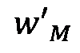


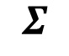
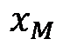
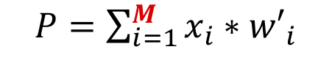












ML-Based Power Proxies Selection
Model construction in two steps
$M$Features
Reach $Q$ non-zero weights
$$x_{1}$$
$Q$retrained weights
$$x_{2}$$
$${w′}_{1}$$
$${w′}_{1}≠0$$
$$w_{1}$$
……
$$Σ$$
……
$$Σ$$
$$Σ$$
Step1: Pruning
Training with strong penalty strength
Step2: ‘Relax’
Retraining
$${w′}_{M−1}≠0$$
$$w_{Q}$$
$${w′}_{M}$$
$$x_{M}$$
$${w′}_{M}=0$$
$P=\sum_{i=1}^{Q}{s_{i}∗w_{i}}$
$P=\sum_{i=1}^{M}{x_{i}∗{w′}_{i}}$
Minimax concave penalty (MCP) for pruning
Notes:
Based on the linear model with M inputs [click], I first perform proxy selection by pruning, which means training the model with certain extra penalty terms in the loss function. As a result, some unimportant weights will shrink to zero.
In this pruning process, my goal is to remove most weights and leave only Q non-zero weights. So I will set the penalty strength to be very large such that most weights shrink to zero.
Then I only keep the signals corresponding to those *non-zero* weights, and they are selected as power proxies.
For the pruning process, [click] I apply the minimax concave penalty (MCP) as the penalty term. This MCP algorithm can maintain the model accuracy during the pruning process. I will briefly explain why on the next slide.
After this selection, I will re-train the model [click] only on the Q selected proxies from scratch in the second step, and the output will be the finalized model.
[9.5 min] [27 min]

Slide 37

Why MCP for Pruning?
To make $Q≪M$, penalty is set to be very large.
Lasso degrades model accuracy under large penalty
MCP protects large weights thus maintains model accuracy
Lasso penalize all weights
MCP protects large weights
Notes:
Before I finish introducing the method, I hope to briefly explain why I choose to adopt MCP as the penalty term, instead of a simpler and more common choice, Lasso or named L1 norm.
This bottom figure shows the value of penalty term with respect to different weight values. The absolute derivative of this penalty term indicates the weight *shrinking rate* during the training process.
For the Lasso penalty, [clock] the absolute derivative of it is a constant number. It means that a *strong* penalty strength will penalize all weights to the same extent, and the model accuracy will degrade significantly due to this strong penalty. Then proxies selection based on the inaccurate model will also be inaccurate.
[click]
In comparison, the MCP protects large weights thus maintains model accuracy during the pruning. In this way, the proxy selection process is based on a more accurate model, and provide *high-quality* selections.
[pause]
So this is the main model construction method in APOLLO, and then let's look at how it performs in my experiment on real CPUs.

Slide 38


Model Training and Testing
Neoverse N1 (infra)
Deployed in AWS Graviton
Cortex A77 (mobile)
Deployed In Snapdragon 865
Experiments on 3GHz 7nm Arm commercial microprocessors Neoverse N1 and Cortex A77
Automatically generate a “diverse” set of random micro-benchmarks for training
Testing on various Arm power-indicative workloads
Notes:
(And) To verify this method, APOLLO is implemented on at least two commercial CPU cores Neoverse N1 and Cortex A77.
The Neoverse N1 is designed for servers, and the cortex-a77 targets mobile devices. Both CPUs are shipping in high-volume.
[click]
I train the model on a diverse set of completely machine-generated workloads, including both lower-power and high-power training workloads.
[click]
Then I test the model on various power-indicative workloads from Arm. The power consumptions of these testing workloads are shown in this right plot. The x-axis is the cycle index, and the y-axis is the power value.
To thoroughly validate our model, these testing workloads also cover a diverse set of power regions, including Steady-state region, transient region and the region when the instruction throttling is turned on.
Now let’s look at how APOLLO performs on these different types of testing workloads.
[11:45]

Slide 39
Prediction Accuracy as Design-Time Power Model
Per-cycle prediction from APOLLO with $Q$=159 proxies
MAE = 7.19%
R² = 0.953
Prediction trace shows great agreement with ground-truth
Notes:
This figure shows the per-cycle prediction from the APOLLO model. Here it only includes 159 power proxies as input.
[click] We can see that the prediction trace in green curve has an excellent aggrement with the ground-truth envelope in pink.
I measure the prediction accuracy in [click] mean absolute error MAE and R-squared correlation. The MAE is around 7%.
[pause]
The error is largely due to the small variations in cycle-by-cycle estimations. Because if you zoom in the curves in more details [click]
[30 min]

Slide 40



Prediction Accuracy as Design-Time Power Model
Per-cycle prediction from APOLLO with $Q$=159 proxies
MAE = 7.19%
R² = 0.953
Per-cycle error can be averaged
40
Notes:
, there are only small error between neighboring cycles. [click] And this per-cycle prediction error will be averaged under larger measurement windows.
In real-world applications, the impact of these minor per-cycle inaccuracies is inconsequential.
Now let’s see an example.

Slide 41

Accuracy on Multi-Cycle Power Estimation
128-cycle prediction from APOLLO with $Q$=70 proxies
MAE = 2.82%
R² = 0.993
Higher accuracy
Notes:
I designed APOLLO to accomodate any larger power measurement window, besides per-cycle power tracing.
For example, I set the power measurement window size equal to 128 cycles in APOLLO, and [click] here is the predicted power traces on the same testing workloads.
Now it only selects 70 proxies as its input, and we can see it achieves even better accuracy than the per-cycle case.
Since APOLLO achieves high accuracy with few proxies, it is possible to **directly synthesize the model at a part of the CPU, and as our runtime on-chip power meter (OPM).

Slide 42










Automated Low-Cost Runtime OPM Implementation
APOLLO is designed to be hardware-friendly
{0, 1}
{0, 1}
Weight
Quantization
High-Level Synthesis
$$w_{1}$$
Implement
{0, 1}
$$Σ$$
$$Σ$$
{0, 1}
Configurable OPM template in C++
$$w_{Q}$$
OPM in RTL
{0, 1}
$W$-bit quantized fixed-point weights
Only $Q$ binary inputs
Verifying
No multipliers required
Verify OPM accuracy
Notes:
To implement the OPM on CPU, I start with the design-time APOLLO model. As mentioned, it only takes Q binary features as input.
[click] Then I perform weight-quantization to get $W$-bit quantized weights, in order to reduce the hardware cost . And since the inputs are binary, [click] we do not need any multipliers in this OPM implementation.
After that, [click] we can easily implement the OPM on hardware by directly configuring an OPM template in C++. And then we do high-level synthesis [click] to generate the OPM hardware design in RTL.
Based on the OPM implementation, we can also easily verify [click] the accuracy of the OPM hardware design, and compare it with the design-time power model.

Slide 43


Prediction Accuracy from Design-time Model & OPM
Per-cycle prediction from APOLLO with $Q$=159 proxies
MAE = 7.19%
R² = 0.953
Notes:
This is the aforementioned prediction results from the APOLLO design-time model. [new page]

Slide 44


Prediction Accuracy from Design-time Model & OPM
Per-cycle prediction from APOLLO with $Q$=159 proxies
MAE = 7.19%
R² = 0.953
Negligible difference
Negligible difference
Prediction from runtime OPM with $Q$=159 proxies
MAE = 7.19%
R² = 0.953
$W$=11 bits after quantization
Notes:
And the bottom figure is the prediction result from the OPM *hardware* after quantization, generated from the C++ implementation.
When comparing these two predictions, [click] their difference is negligible. Both models select 159 power proxies. And we can see there is almost no accuracy degradation after quantizing weights into eleven bits.
In this way, I generate the OPM on hardware without sacrificing accuracy.
Then let's look at how I design this OPM to achieve the low cost.
[33 min]
////Then let’s look at the hardware design of this low-cost OPM.

Slide 45

Overview of the OPM Hardware Design
No multipliers or dividers, only Q binary inputs and W-bit quantized weights
Notes:
This is an overview of the OPM hardware design, which consists of three major parts and is easy to implement.
[click]
First, The “interface" latches the input signals using the register interface. Then it extracts per-cycle toggling activities as binary input for each proxy.
[click]
Then the “computation” component calculates the *per-cycle power* based on the quantized weights w and proxies x.
[click]
Finally, it uses one counter to support the calculation of averaged power with any T-cycle measurement window.
The window size T can be set to *any number* equals to the power of 2, such that the division is realized by directly dropping the lowest log T bits.
In this OPM design, [click] it only includes Q binary inputs and same number of quantized weights. There are no multipliers and only one counter. So this cost is much lower than all previous works.
[pause]
For this OPM hardware design, of course there is still a trade-off between accuracy and hardware implementation cost. Let's look at a study on this *trade-off*.

Slide 46




Accuracy vs. Hardware Cost (Area Overhead) of the OPM
Runtime OPM implementation on Neoverse N1
Trade-off accuracy and hardware cost
Sweep proxy num $Q$ and quantization bits $W$
Error Measured on HW (%)
Num of Bits ($W$)
Num of Power Proxies ($Q$)
OPM Gate Area Overhead:
0.1% 0.2% 0.3% 0.4%
Notes:
Here I measure the OPM *accuracy* in error in the Z axis [click] and use the color [click] to indicate OPM hardware cost measured in area overhead.
[click] Then I study the trade-off by choosing different input proxy num $Q$ and weight quantization bits $W$.
And this is the measurement result [click].

Slide 47


Accuracy vs. Hardware Cost (Area Overhead) of the OPM
Runtime OPM implementation on Neoverse N1
Trade-off accuracy and hardware cost
Sweep proxy num $Q$ and quantization bits $W$
Strategy
Keep quantization $W$= 10 to 12 bits
Vary $Q$ for different solutions
For an OPM with $Q$=159, $W$=11
< 0.2% area overhead of Neoverse N1
< 10% in the error
One OPM solution
Error Measured on HW (%)
Num of Bits ($W$)
Num of Power Proxies ($Q$)
OPM Gate Area Overhead:
0.1% 0.2% 0.3% 0.4%
Notes:
Based on this result, my strategy [click] is to keep quantization bits W in a reasonable range, then vary Q for different solutions.
[pause]
For example, [click] for an OPM solution at this point, the proxy number Q equals 159 and quantization bit W equals 11. This OPM hardware solution achieves [< 0.2% area overhead of the CPU] and [< 10% in the error]. It indicates low hardware cost and high accuracy achieved at the same time.
[pause]
So up to now I have covered how the model performs for design-time modeling and runtime power estimation.
Based on the unique capability of this method, APOLLO actually opens up multiple new application areas that are beyond what is possible in the previous works.
And in this talk, I will highlight two of them, one for design time and the other for runtime.
[11 min]

Slide 48


Potential Application: Design-time Power Introspection
Trained only with more meaningful signals as initial feature candidates
Distribution of power proxies on Neoverse N1
Better interpretability
Identify power contributors for designers!
Notes:
The first application of APOLLO targets benefiting design-time power optimization. To achieve this, we can use the model to analyze power-contributors for designers.
APOLLO selects various types of signals as proxies, as this pie chart shows. These proxies are from different sub-blocks. However, in practice, some signals are actually semantically more meaningful to designers. So it is beneficial to create an APOLLO model, [click] only with designer-identified signals as the initial feature candidates.
In this way, the resulting model has much better inter--pretablity and these *more meaningful contributors* can benefit design decisions.
So [click] this is one application at design time, to identify power contributors for our designers.

Slide 49




Potential Application: Runtime dI/dt Mitigation
$dI/dt$ Predicted (scaled)
Log-scale
$dI/dt$ Observed (scaled)
Enable CPU-driven Proactive $dI/dt$Mitigation!
Notes:
The second potential application of APOLLO is for runtime.
Like I mentioned, abrupt changes in current demand, name di/dt events will trigger deep voltage droops in very short time. So we need very fast detection and mitigation techniques.
To solve this, we can apply the APOLLO-OPM in proactive di/dt mitigation and result is shown in this plot. The y-axis shows per-cycle di/dt *prediction* from OPM and the x-axis shows the ground-truth.
As shown here, the Pearson coefficient is around 0.95, indicating high correlation between OPM estimations versus ground-truth.
Note that [click] the axes here are in log-scale to visually magnify the uncorrelated sample points, which are actually very small in magnitude.
This plot indicates that large excursions for both voltage droop and overshoot are accurately capture by the OPM.
[click] So this is one application at runtime, which enables CPU-driven proactive dI/dt mitigation

Slide 50
What I Believe We Should Target
Unified ML for Both Design & Runtime
Auto-ML for Chip Design
Benefit the whole chip life cycle
ML for Chip Design
Higher-level of automation
Well-studied in recent years
Traditional Chip Design
Notes:
To sum up, by achieving my higher goal in a unified ML model for both design and runtime, this work named APOLLO has a material impact in how we design and deploy CPUs.
It enables many potential applications, from power/thermal management in SoCs to CPU-driven proactive dI/dt mitigation.
And I believe this may even become a standard design-operation and common-component in future CPUs and even other compute solutions.

Slide 51




Summary and Takeaway
Problem: Increasing Challenges in Chip Design
Cost, time-to-market, reliance on designers, diminishing performance return, ……
ML in chip design
Less simulation time, faster feedback, less designer effort
AutoML in chip design
Reduces months of model development to hours, no developers
Unified ML in both design & runtime
Benefit the entire chip life cycle
Vision
Chip design & implementation
Intelligent Solutions
Notes:
[38 mins]
New: 8+9+20 = 37-38 mins
And now it comes to the summary and the key takeaway of my talk.
My research is motivated by the increasing problems and challenges in chip design and implementation. They include increasing design cost, longer turn-around time, reliance on human engineers, and so on.
To solve this, intelligent design methodologies and solutions are proposed.
[click]
The first and mostly studied solution is ML for chip design. It proves to achieve less simulation time, faster feedback, and less designer effort.
Besides this, I believe there are higher goals we could target.
[click]
2. For example, We need AutoML in chip design, which relieve developers from the long development cycle of customized ML models.
[click]
3. In addition, we need ML in both design and runtime. In this way, it benefits the entire chip life cycle.
[click]
This bottom figure shows my vision. I want better chip quality with lower cost, also with less human engineering effort, shorter turn around time, and less computation and carbon emission.
Imagine I could improve chip performance by 30% with the same power consumption, while reducing both the number of engineers and the time-to-market by a half, what a huge profit it would make for every chip design company. And this is actually possible, because the traditional algorithms are far-from being perfect.

Slide 52

Future Research Plan
Unified ML for Both Design & Runtime
Auto-ML for Chip Design
ML for Chip Design
Collaborative
framework
Traditional Chip Design
Ph.D.
Timeline
Notes:
Now let’s look *back* at this roadmap. My journey starts with the traditional chip design and reached unified ML for both design and runtime. I see great potential and high industrial demand of this method, and I don’t want it to stop here. That’s why I am here for this interview. :)
[click]
For my future research plan, I will start with this and keep the snowball rolling. My first task in the future is to pull everything together and build a framework.
In addition, I want the framework to support collaborative training, in order to solve the serious data availability problems. Let me explain more about it

Slide 53



Future Works: Collaborative Framework
Collaborative ML in Chip Design
Example $−$ Collaborative Training
Model quality depends on data
Circuit data from different companies
Design data is highly confidential
Federated Learning:
Train on local data
Communicate weights
One same model in a row
Nine different models in a row
Assuming data distributed to 9 clients (C1 to C9)
Notes:
We know that the quality of machine learning models depends on the quality and amount of *training data*.
However, for chip design, those cutting-edge design data is distributed at different semiconductor companies. And they are highly confidential. It is impossible for them to directly share their data with model developers.
[ Even for industrial developers with access to their own data, their data can still be insufficient and biased. ]
So we better train the model collaboratively from different clients, and without directly *accessing* their data. And this is possible.
My initial solutions can be based on ideas of federated learning, which only performs training locally and only communicates weights with clients.
===
[click] As my study in this example shows, assuming there are nine different clients providing different data, collaborative training gives much better results than constructing models locally for each client. So this direction looks promising.

Slide 54
Future Research Plan
Fully-automated & reliable framework
Collaborative
framework
Ph.D.
Short-term milestone
Notes:
And this will be my first goal. It targets the data availability problem and switch from the individual intelligence to collaborative intelligence.
[pause]
Besides that, [click] I want to further achieve a fully-automated and reliable framework. This will make the framework very easy to improve and safe to use. Let me explain more.

Slide 55


Future Works: Fully-Automated & Reliable Framework
Fully-Auto ML in Chip Design
Example $−$ Feature Selection
Automated feature selection
Automated data selection
Automated data augmentation
The first conv layer:
32 kernels with size 3x3x24
24 feature weight vectors
Data
# Features | ROC-AUC
2 ( ) | 0.866
4 ( + ) | 0.867
24 (all) | 0.867
Selected Features:
0. Pin density
12. MST fly lines
22. DFF cell density
23. Clock tree cell density
ML
Model
Feature
Notes:
One target is fully-automated method. It is more than what I have presented in aforementioned auto-ml work for routability prediction :) .
Actually ML methods include at least three key componenets, which are data, feature and model. We only automated the model delopement part in the previous work.
In the future work, I will automate the feature selection, the data selection, and data augmentation steps. In this way, we can very easily improve existing model or develop new models in my framework without much engineering effort.
====
[click]
For example, I tested a straightforward method to select features by corresponding weights in the ML model. And it turns out to work pretty well. There is almost no accuracy degradation for models only with select features, ///in this simple experiment

Slide 56



Future Works: Fully-Automated & Reliable Framework
Reliable ML in Chip Design
Example $−$ Design Difference
Designs very sparsely distributed
Almost impossible to perform well on every test case
How can we trust each prediction?
ISPD-1
ISCAS’89
ISPD-2
Faraday
OpenCore
ITC’99
Notes:
The other target is reliable models in my framework.
Here is the motivation. If we view the circuits from the data-mining perspective, compared with ordinary image data, those design data are very sparsely distributed in the feature space.
This is because circuit designs can be hugely different from each other, in terms of functionality, micro-architecture, technologies node, and so on. As a result, honestly, it is almost impossible for a single ML model to perform well on every test case.
Then this brings a serious problem, which is how can we trust each prediction result? So we really need reliable ML models in this case to make the framework safe to use.
====
[click]
For example, I tried to directly measure the similarity between circuit designs, and the output is rather reasonable. The designs from the same benchmark are close to each other in the same cluster. Perhaps we can use similar techniques to study the similarity between training and testing dataset, and to guide us to build the reliable framework.

Slide 57

Future Research Plan
Need knowledge on optimization, computer architecture, etc.
Need knowledge on ML, circuits, software, etc.
Multi-domain/objective, efficient optimization
Comprehensive framework from system-level to testing
Accommodates emerging tech
Fully-automated & reliable framework
Collaborative
framework
True intelligence in chip design
Ph.D.
Short-term milestone
Longer-term milestone
Notes:
So building this framework will be my short-term goal. It should support fast estimations on all important design objectives and can be applied at different design stages. And I will have it validated on cutting-edge design flow and circuits at that time.
And to achieve this, [click] I need many collaborations, including but definitely not limited to experts with knowledge on ML, data schience, circuits and systems, software engineering, and so on.
[click]
After that, I will keep improving this framework. For example, instead of using separate models for single objective predictions, I target multi-domain, multi-objective *optimization*, which directly optimize the quality of circuits, making this framework much more productive and easy to use. In addition, considering many ML models are huge, I will need to target efficient optimization based on these huge models.
[click]
In addition, I will target making predictions and optimizations at earlier design stages and higher abstraction levels like system architecture level, or considering software-hardware co-design. This brings much more design flexibilities and larger benefits. Also, I would like cover the circuit verification and testing steps. In this way, this is a comprehensive framework covering the whole circuit development flow.
If possible, I hope the framework could also benefit the analog design.
[click] To achieve this, besides previous collaborations on circuits and machine learning, I also need help from experts on optimization, computer architecture, circuit verification and testing, and so on.
[click]
Finally, this framework should accommodate emerging technologies at that time.
And my final goal, like mentioned by the title my talk, is truly intelligent circuit design and implementation.. I believe this will be the holy-grail in design automation, but perhaps with some side-effect that putting some engineers out of job :)

Slide 58

Future Funding and Collaboration Opportunities
Agencies:
General Research Fund (GRF), Early Career Scheme, NSFC, ITF
US companies:
Cadence, Synopsys, Nvidia, Arm, NXP
Chinese companies:
Huawei, Alibaba T-head, Chinese EDA start-ups like UniVista
Semiconductor manufacturing capacity (%)
US
China (mainland)
US restricts software exports to Chinese chip companies
Semiconductor switching to Asia, including ‘Greater Bay Area’
A great chance to overtake leading EDA companies
Notes:
And of course I need funding to support this research plan.
Here I listed some funding opportunities in the future, from both agencies and companies. For example I will definitely apply for general research fund (GRF), and early career scheme. I will also try to get NSFC and ITF.
As for the industry, in United States, I have worked with multiple semiconductor companies and some of them have already funded my research.
And there is also a high chance to get funding at HK from Chinese chip companies like Huawei, Alibaba T-head, and other Chinese EDA start-up companies. Some of them have showed great interest in my research.
In addition, this is a special time for Chinese chip companies, since US has restricted their software export. On the other hand, the semiconductor industry is inevidebly switching to Asia, including the ‘Greater Bay Area’. Both factors contribute an unprecedented high demand to chip design technologies from China.
So I believe my research direction will be in *even* greater demand in the near future. And this is a great chance to catch up or even overtake those leading EDA companies with intelligent techniques.

Slide 59
Previous Collaborations and Grant Writing Experiences
Many thanks for my advisors and collaborators:
My previous grant writing experiences (funded):
NSF: Revitalizing EDA from a Machine Learning Perspective
SRC: A Machine Learning Approach for Cross-Level Optimizations
SRC: A Collaborative Machine Learning Approach to Fast and High-Fidelity Design Prediction
Industry (Cadence): NAS-based Fully Automatic ML Estimator Development Flow in EDA
Industry (Cadence): A Machine-Learning based Pre-placement Wirelength Estimator
Prof. Yiran Chen
Duke University
Prof. Hai “Helen” Li
Duke
Prof. Jiang Hu
TAMU
Dr. Brucek Khailany
Nvidia
Dr. Haoxing Ren
Nvidia
Dr. Shidhartha Das
Arm
Dr. Xiaoqing Xu
Arm
Dr. Brian Cline
Arm
Dr. Chand Kashyap
Cadence
Dr. Aiqun Cao
Synopsys
Notes:
Also, I would like to thank the supports from my advisors and previous collaborators.
And here listed my experience on writing grant proposals. I write them together with my advisor.
My research is supported by NSF, and semiconductor research corporation (SRC), and other companies.

Slide 60
Courses I am Qualified to Teach
Circuit and Computer Engineering Courses
Digital VLSI design, digital integrated circuits (CAD admin at Duke)
Chip design methodologies
Digital logic & systems (TA of undergraduate course at Duke)
Computer organization and architecture
Machine Learning Courses
Linear algebra for engineering (TA of graduate course at Duke)
Data mining, artificial intelligence, machine learning
Computer vision, deep learning
Notes:
Finally, I would like to briefly talk about teaching.
I am qualified to teach two large categories of courses. One is related with computer hardware. From the VLSI design and circuits to digital logic and computer architecture. Of course also include the chip design methodologies.
The other category is related with machine learning. From fundamental techniques in machine learning to advanced topics in deep learning, especially from the computer engineering perspective.
So this is the end of my talk, I just thank all of you for your time and attention.
I am so glad to be here, and I will be thrilled to take all of your questions. Thanks!

Slide 61
Thanks! Questions?
If you have further questions, please contact me:
zhiyao.xie@duke.edu

Slide 62
Automatic Estimator Development – Search Space
Sampling
Sampling
[Chang, et al., ICCAD’21]
Notes:
In this work, the idea of automating estimator development is well implemented by our first-year phd student, Chen-chia. Chang.
This figure shows the general model architecture of our proposed routability estimator.
There are altogether six blue blocks, representing large searchable parts, and the yellow blocks are simple fixed parts.
======
[click] Then we look at the search space of each blue searchable block.
Each block is independently sampled from this completely-ordered graph with seven nodes. Each node denotes one convolutional operation, and each edge denotes the data path.
[click]
- For each node, its convolutional operation is selected from four options. The first two options are standard convolutions with 32 or 64 kernels. Denoted as the C32 and C64 here.
Besides these standard convolutions, we also include the Atrous or named dilated convolution in the candidate operation. As this animation shows, it looks at a *larger* range of inputs. In addition, we also include a more complex option, [-It is a mixed convolution operation]. It supports different size of convolution kernels for different channels.
As for the edges, since these edges are [- sampled from completely-ordered graph], So it supports any combinations of node connections.

Slide 63
A Workload Execution Preview of APOLLO
40K cycles of APOLLO Power Estimation out of a trace of 17M cycles
hmmer (SPEC 2006) simpoint
on the Neoverse N1 CPU core
~2 weeks execution time reduced to few minutes (90-95% accuracy)
Unprecedented single-cycle temporal resolution
Notes:
This is a workload execution preview using APOLLO. This trace is hmmer simpoint from SPEC.
The entire simpoint consists of 17 Million cycles, and here we show part of the trace. [click] Simulating this simpoint based on the emulator takes about 2 weeks overall. In comparison, APOLLO can approach within 90-95% of the accuracy within a few minutes.
Also, I want to emphasize the per-cycle temporal resolution in this plot. This fine-grained temporal resolution enables unprecedented power introspection, and cannot be achieved by other techniques with this speed.
So these are the strength of APOLLO, now I will start to introduce how we construct such a model.
[4.5 mins]

Slide 64

Our Proposed Power Modeling Approach
A “diverse” set of random (micro-)benchmarks is critical
Training data automatically generated
Model training & testing
Micro-architecture agnostic genetic algorithm to automatically generate max-power virus
A “diverse” set is generated: lower-power in early generations and higher-power in later generations
Experiments on 3GHz 7nm microprocessors Neoverse N1 and Cortex A77
Testing on Arm power-indicative workloads
Steady-state, transient, and throttling regions
High- and low-power-consumption regions
Power virus generated
Start with low-power benchmark

Slide 65
Summary and Conclusions
Fast power-modelling has a material impact in how we design and deploy CPUs
Micro-architecture agnostic methodology is automated and can scale to multiple compute-solutions – CPUs, GPUs, NPUs and even for sub-blocks
Potential applications extend from power/thermal management in many-core SoCs to CPU-driven proactive droop-mitigation
ML/Data-Science approaches are potential disruptors to many aspects of design
Notes:
In summary, [click] we propose a fast power-modelling method, which has a material impact in how we design and deploy CPUs
-- with the help of accurate power-introspection, we can better understand and analyse the impact of micro-architectural features
-- Runtime introspection can help in managing both sustained power-consumption and transients
In this work, [click] Microarchitecture agnostic methodology\ is automated and therefore, it can scale to multiple compute-solutions. Not limited to CPUs, also for GPUs, NPUs and even for sub-blocks
[**click] This work enables many potential applications, from power/thermal management in SoCs to CPU-driven proactive droop-mitigation
And lastly, [click] we believe ML/Data-Science approaches are potential disruptors to **many aspects of design.
-- Not just power, but also other aspects in physical design and micro-architecture design exploration.

Slide 66

FAQ: Prior Power Modeling Works
Comparison among various power modeling approaches. The percentage numbers are area overheads.

Slide 67


FAQ: Accuracy Comparison
Neoverse N1 CPU core
Cortex-A77 CPU core

Slide 68



FAQ: Accuracy with Multi-cycle Measurement Window
During inference:
Q = 200 for Simmani
Q = 70 for APOLLO

Slide 69























$$w_{1}$$
$$[0:W]$$
$$s_{1}$$
TD
$$x$$
$$[1]$$
+
$$s_{2}$$
$$[0:1]$$
$$w_{2}$$
$$[0:W]$$
TD
FF
out
$$x$$
+
D
Q
$$[2]$$
+
TD
rst
register interface
$$w_{3}$$
$$[0:W]$$
T-cycle counter
$$s_{3}$$
TD
$$x$$
$$[3]$$
+
Output:
$$w_{4}$$
$$[0:W]$$
$$s_{4}$$
out
$$[log(T):MSB]$$
TD
$$x$$
$$[4]$$
Inferface
Computation
T-cycle average
TD
1-bit toggle detector with one XOR and FF
FF
Flip-flop
Notes:
This slide shows an overview of the OPM hardware design, which consists of three simple parts and is easy to implement.
Finally, it uses one counter to measure averaged power of T-cycle maesurement window. The T is any number equals to the power of 2, such that the division is realized by directly dropping the lowest logT bits.

Slide 70
Overview of the OPM Hardware Design
No multipliers or dividers, only Q binary inputs and W-bit quantized weights
Notes:
This is an overview of the OPM hardware design, which consists of three major parts and is easy to implement.
[click]
First, The “interface" latches the input signals using the register interface. Then it extracts per-cycle toggling activities as binary input for each proxy.
[click]
Then the “computation” component calculates the *per-cycle power* based on the quantized weights w and proxies x.
[click]
Finally, it uses one counter to support the calculation of averaged power with any T-cycle measurement window.
The window size T can be set to *any number* equals to the power of 2, such that the division is realized by directly dropping the lowest log T bits.
In this OPM design, [click] it only includes Q binary inputs and same number of quantized weights. There are no multipliers and only one counter. So this cost is much lower than all previous works.
[pause]
For this OPM hardware design, of course there is still a trade-off between accuracy and hardware implementation cost. Let's look at a study on this *trade-off*.

Slide 71

FAQ: Model Discussion
Sum of all absolute weights
Variance inflation factors (VIF)

Slide 72


Neural Architecture Search
Neural Architecture Search (NAS) enables design automation of ML models efficiently without human interventions
Human knowledge
Traditional DNN Design
Neural Architecture Search
Wu, Bichen, et al. "Fbnet: Hardware-aware efficient convnet design via differentiable neural architecture search." Proceedings of the IEEE Conference on Computer Vision and Pattern Recognition. 2019.
Notes:
With Neural Architecture Search techniques, it enables design automation of ML models in an efficient manner and without human interventions
In the left bottom figure, it is the traditional ML model design flow. Human uses their own knowledge to select the model structures and train this model to get the performance.
Then, they will key trying another structures or just modify some part to get another performance.
But this will cost lots of develop times and it is not efficient. It may costs weeks to develop.
For the right figure, we use Neural Architecture search. First, the machine will fetch some models from its search space, then it will also train and get the performance.
Then, we can design some algorithms to help us to sample another models from our space according to the performance.
The algorithm can help us finding well performance model through the iterations.
So, we can automatically get the best model through this search process. And it can save lots of times and can find some models that beyond human knowledge.

Slide 73
Search Strategy
Define a weight on each edge to control its sampling probability
Sample edges from the guide-DAG with probabilities
Updating flow
Preprocessing
Loop: while the performance of model not converges
Subsample guide-DAGs according to the weights
Train the model on our dataset to get performance metrics
Update connection weights
Higher performance leads to higher weights on edges
Notes:
According to the flow of the evolutionary algorithm, we can know that the choice of mutation and cross-over greatly affects the quality of our explored models.
Here we give the introduction of our mutation and crossover operations.
In these operations, we first map each searchable options in the search space into an n dimensional binary vector.
Therefore, each binary number can represent a hyperparameter choice in our search spaces.
// For example, …
Then, we use a popular polynomial mutation method to mutate our population.
We can control the mutation rate under a polynomial setting, and this method encourages diverse offspring models.
In other word, we can flip many bits at the same time to mutate our architecture.
In crossover, we use binary crossover method.
It selects two population members as parents to create the offspring.
An example is illustrated in the figure below.
The children will inherit the structures from their parents and potentially can preserve their good parts of architectures.

Slide 74

Results from Automatically Developed Estimator
This model outperforms RouteNet [ICCAD’18], PROS [ICCAD’20], and cGAN [DAC’19]
Automatically developed without human in one day
ROC-AUC of DRC hotspot detection
[ICCAD’21], Session 9c: Automatic Routability Predictor Development Using Neural Architecture Search
Notes:
This is my collaborative work published in this ICCAD. I cannot cover the searching algorithm due to the time limit. Please go to our session for more details if you are interested.
What I want to emphasize is, this automatically developed model turns out to work surprisingly well. It outperforms many representative routability estimators.
And more importantly, this model can be developed without human engineers in one day.
[4 mins]

Slide 75


Experimental Results – Accuracy
Comparison of the violated net count prediction
Comparison of the DRC hotspot detection
Notes:
And here is our result.
For thre three representative previous works, only RouteNet performs [-violated ….]….. while all of them preforms …..[DRC hotspto detection].
So for the violated net count prediction, we compare our NAS-crafted model with RouteNet, and evaluate the accuracy with Kendall’s tau ranking coefficient and the Pearson’s correlation. Here we firstly demonstate accuracy comparisons on four representative designs with largely different sizes, from hundreds to tens of thousands. After that, we measure the averaged accuracy on all placements from all designs in our dataset. We can see the NAS-crafted model obviously outperforms the RouteNet as the baseline.
//// Notice that all models are trained and tested on different designs. We get accuracy on all designs by cross-validation.
As for hotspot detection, we compare with all baseline methods. Similarly, we observe superior accuracy of the NAS-crafted model. Even though we have tried best to tune the accuracy of baselines PROS and cGAN, they still show limited accuracy. This may be caused by our comprehensive dataset with many largely heterogeneous designs./// [- as a result these baselines are too complex and can not generalize very well]

Slide 76


Proposals
A scenario of cross-domain optimization
Tuning by semi-supervised learning

Slide 77


Cost on IR Drop Identification
Time-consuming simulations performed repeatedly
Provide feedback
Edit the design
Simulation to get IR drop hotspots
~4 hours on 1M cells
Not only once!
Check other trade-off design objectives
Simulate again
ML-based algorithm: 5 mins, 93-99% accuracy

Slide 78
IR Drop Estimation Methodology
The location to check IR drop
Look at power at larger region
IR drop value
CNN model
Input region with
power distribution
Neighbors contribute power/current demand at the local region

Slide 79

Incorporate Timing with Customization
Part of Input Region
Maximum current demand
Worst IR drop
Switch early
Cells
Signal propagation
Switch late
Power/current consumption depends on switching activities
Gates switch at different time frame!

Slide 80
Our Customized Method
Maximum structure with CNN
Power map at
time frame 1
Input Region
IR₁
P
Same CNN
P
Switch early
……
……
Max
IR
Power map at
time frame N
Switch late
IR_{N}
Same CNN
Performs end-to-end training
P

Slide 81

Timing Estimation on Netlist is Inaccurate
Circuit Layout
Circuit Netlist
Placement
Hours-days
Inaccurate timing estimation due to absence of wire length
Better timing estimation
Edit netlist if necessary
Notes:
In digital circuit design, timing is a primary design objective that needs to be considered since early design stages. However, [click] it turns out the timing estimation on circuit netlist can be highly inaccurate. This is due to the absence of wire length information at this stage. And the current estimations on wire length is very inaccurate.
Only after the placement step, [click] which may take hours to days, we can get more accurate timing report based on the generated circuit layout.
However, [click] if necessary, we need to go back and edit the netlist based on our accurate timing report. As a result, this may take multiple iterations and require us to run the timing consuming placement step multiple times.
We hope to avoid this inefficient iteration loops if we can make accurate timing prediction before placement. And the key problem is, why existing techniques cannot make accurate estimation on the wirelength of each net?

Slide 82
Example: Timing Estimation before Placement
Circuit Layout
Circuit Netlist
a
b
Placement
Hours-days
Net-length?
Net-length?
Traditional tools: Same!
Previous works: Similar!
Net-length a
>>
Net-length b
Delay a
>>
Delay b
Notes:
Let‘s look at one simple example. Assuming there are two similar nets in the netlist, the net a and b. We hope to estimate their net-length for timing prediction.
If we look into both nets, we notice that they have exactly the same topology, and even the same 1-hop neighbors. Based on this observation, [click] traditional tools will believe that, ”OK, their net length should be the same!”. In comparison, some previous works will say “perhaps they are not exactly the same, but their net lengths should be very similar”.
However, according to my experiment, this is not true. [click] After the placement step, as shown in the right plot, the net length of net a can be significantly larger than net b. [click] As a result, the delay of net a can also be significantly larger. ///// [delete] In one small design, there can be dozens of net a and hundreds of net b with highly similar topologies.
This example shows the limitation of many heuristic-based previous methods. In order to distinguish very similar nets, we should not be limitied by local information only, but need to capture the impact from the whole netlist.

Slide 83



Our Solution to Capture Global Information
Process as Graph
Partitioning
Extra Info
Customized GNN
p₃
p₁
a
>>
net-length
b
Recognize net-length
Timing model
p₂
Reduces 50% error in commercial timing engine
Notes:
In our solution, for each given circuit netlist, [click] we process the netlist as a graph. We view the each net instead of cells as a node because we focus on net size in this work.
To build a more accurate model, [click] we try to capture more global information by performing fast partitioning on the netlist. Then we define multiple features based on the partitioning results. One straightforward intuition is that, if two cells are assigned to different partitions, like p1 and p2, then the distance between these two cells tends to be larger after placement. [click] These generated features are provided as extra input in the graph.
Then we propose our customized graph neural network (GNN) model to process the graph and predict the net length labeled on each node. Experiment results show that this model can recognize the net length of a is significantly larger than net b.
And remember that, our ultimate goal is to estimate timing accurately, so we further construct our own ML-based timing model [click] based on these estimated net legnthes. Compared with pre-placement timing engine in commericial tools, our model proves to reduce the error by 50%.

